Slide 1
ISPD’24 Contest: GPU/ML-Enhanced Large Scale Global Routing Contest
Rongjian Liang, Anthony Agnesina, Wen-Hao Liu, Mark Ren
NVIDIA

Slide 2
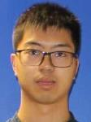
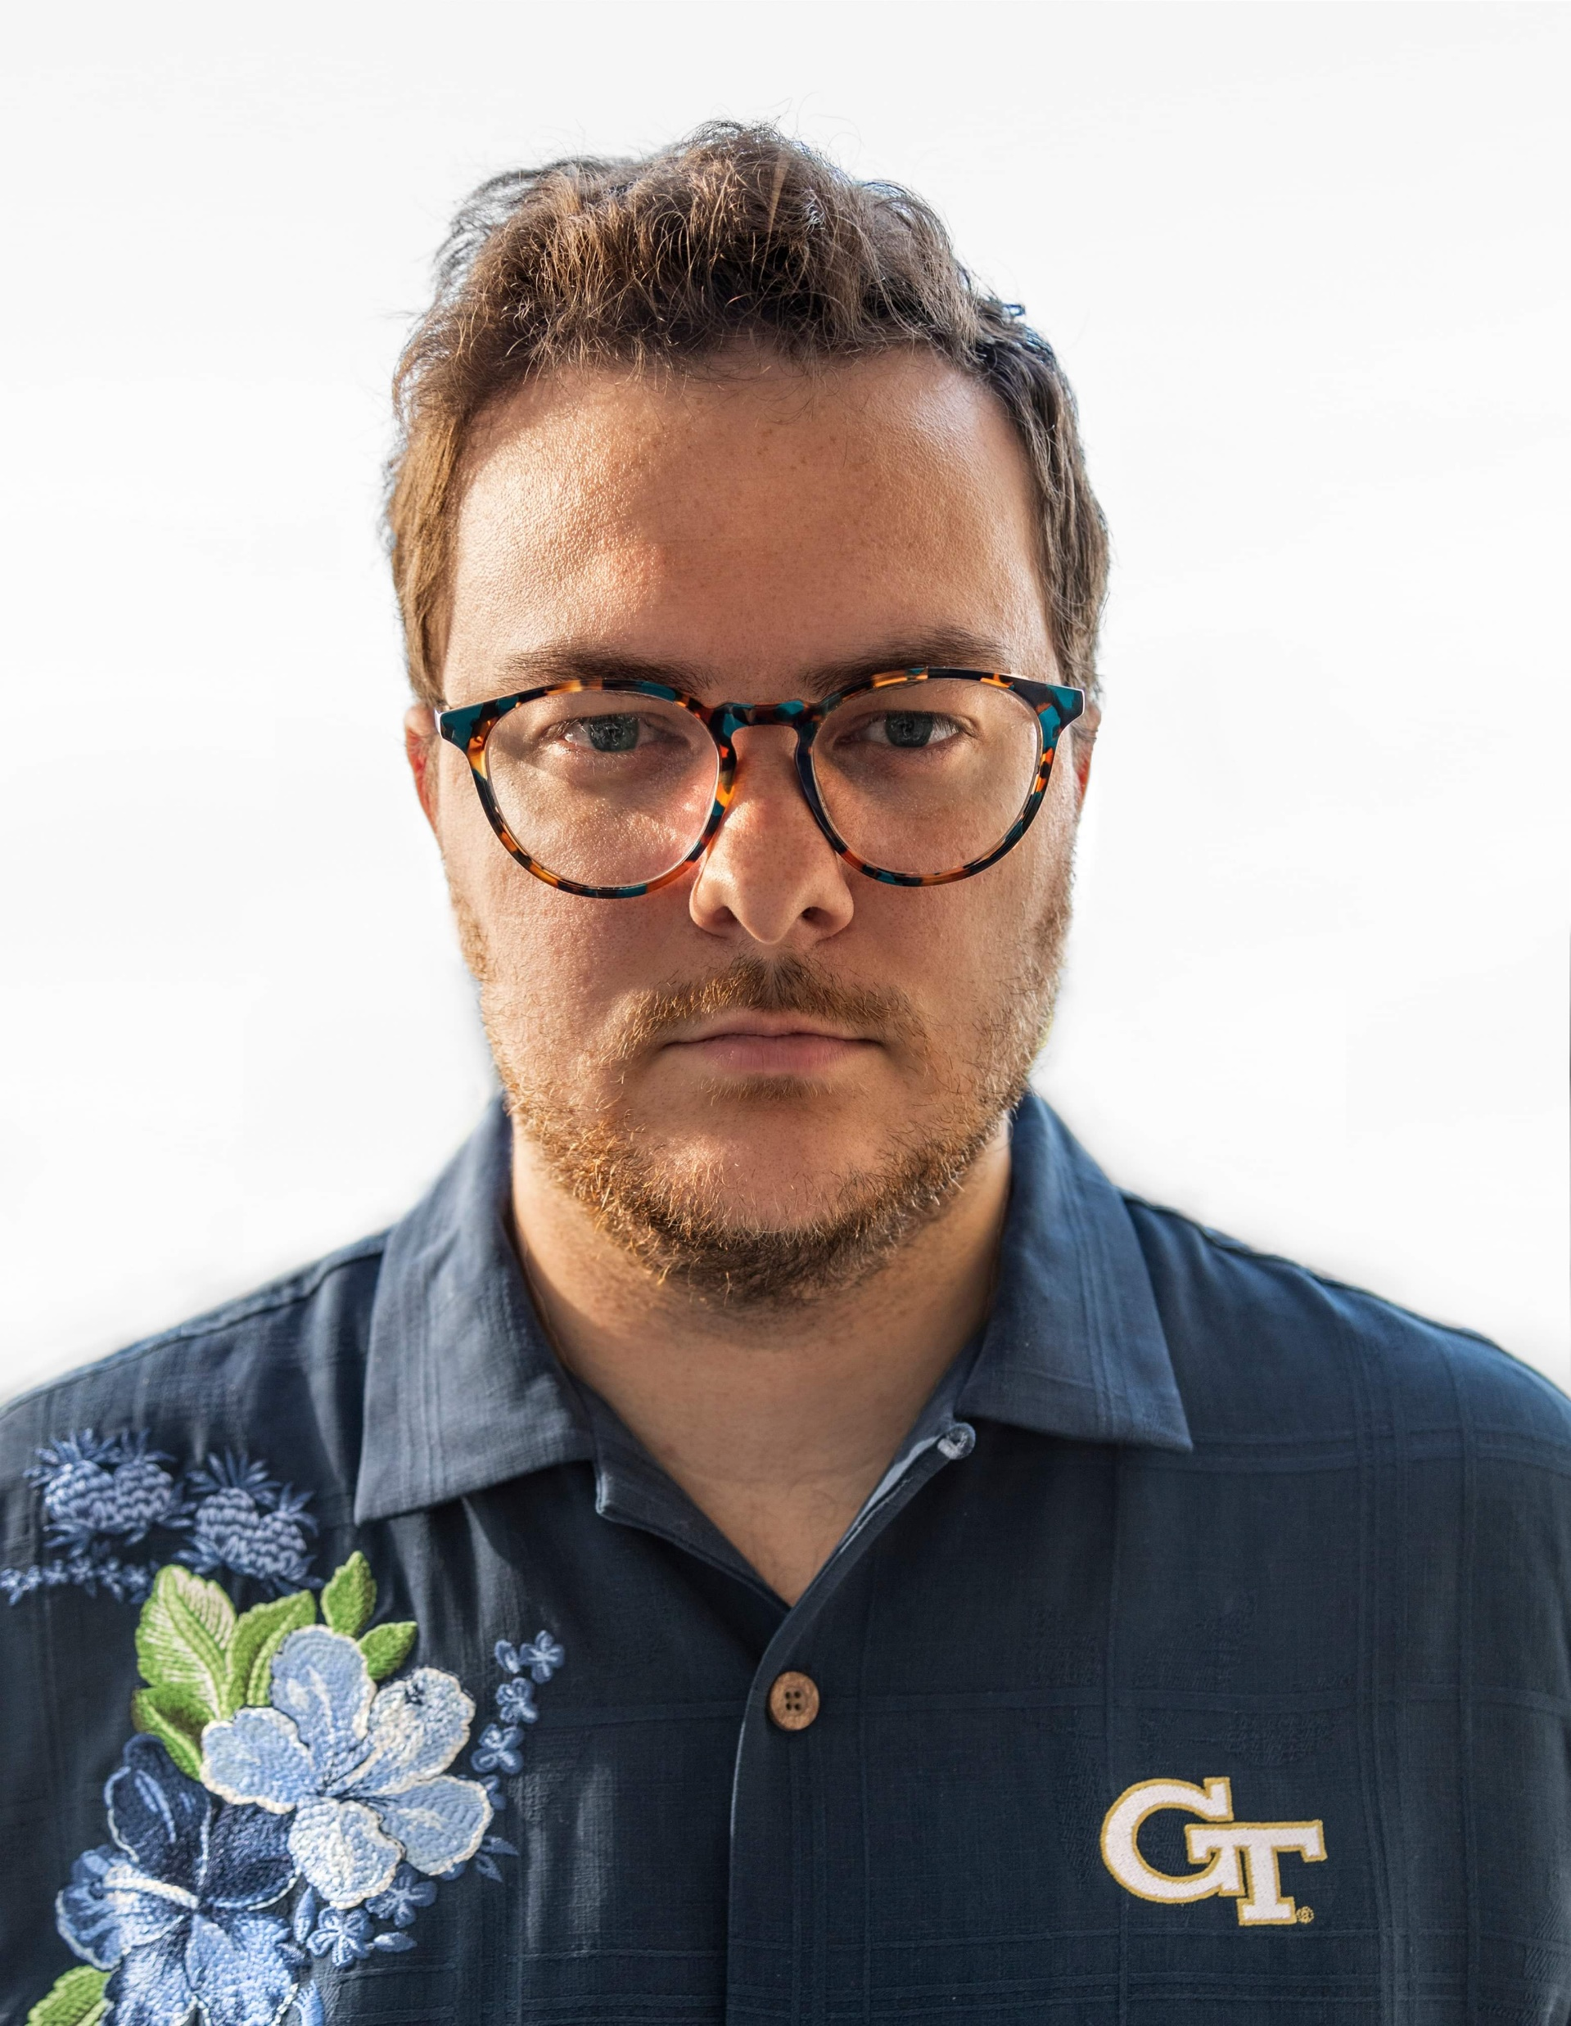
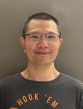
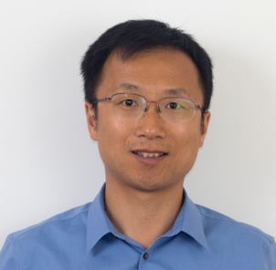
Contest Organizers
Rongjian Liang
Problem formulation & Evaluation
Anthony Agnesina
Benchmarks
Wen-Hao Liu
Evaluator
Haoxing (Mark) Ren
High-level guidance

Slide 3
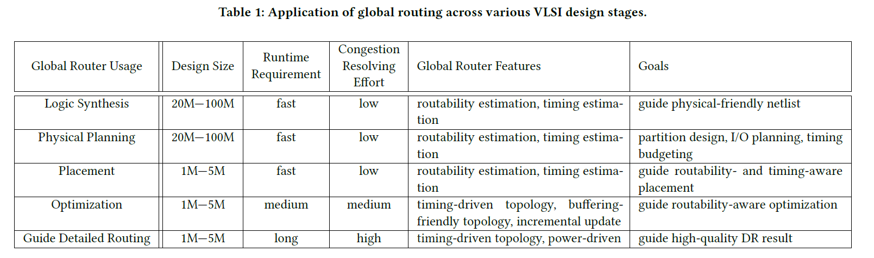
Motivations
Global routing techniques have many applications across various stages of modern VLSI design flow
Scalability of global routing techniques is a serious challenge
GPU acceleration and ML techniques have great potential to address the scalability challenge

Slide 4
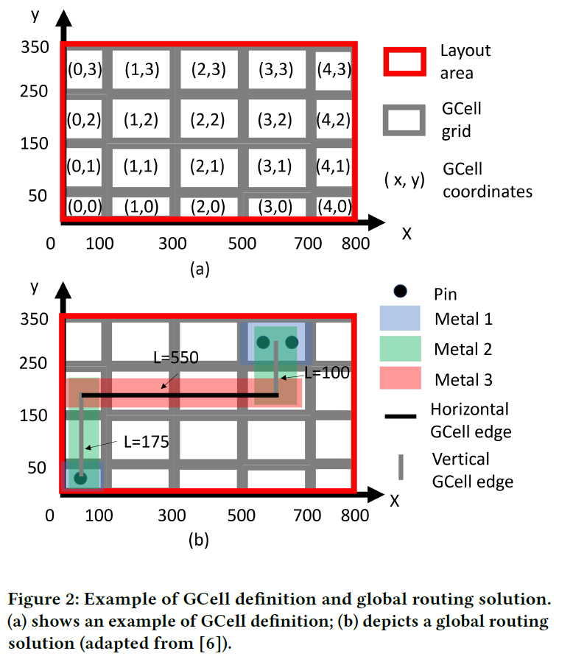
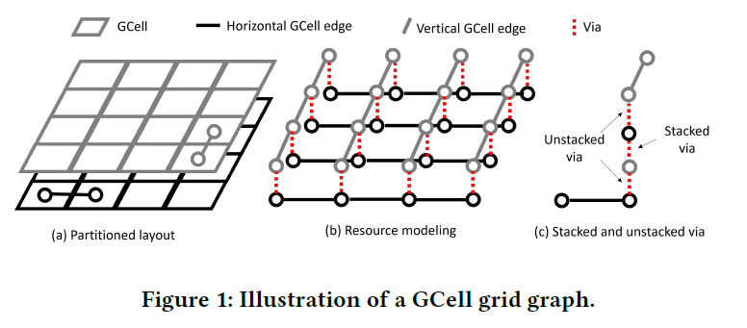
Problem Formulation
Input
A 3D routing space defined using a GCell grid graph (.cap file)
Net information (.net file)
Output
Routing guide on the Gcell grid graph
Objectives:
A concrete path for each net
Minimize total wirelength
Minimize via count
Minimize overflow

Slide 5
Distinctions Compared to Previous Routing Contest
Large scale testcases (up to 50M cells) and tight runtime/memory budgets (< 50000s and 200GB RAM)
GPU server to encourage the usage of GPU acceleration and ML techniques
Simplified input/output formats
Two sets of evaluation metrices to advance the frontier of global routing techniques applicable across various stages

Slide 6
Benchmark Suit Characteristics
The benchmarks derived from [1]
The benchmarks are synthesized using the nangate45nm technology and cell libraries
The benchmarks are divided into two sets
One placed layout from each design for testing (public)
Another placed layout from each design for final ranking (blind)
Simplifications for the contest
Power and ground nets are removed
Clock tree routing is not considered
[1] C.-K. Cheng, A. B. Kahng, S. Kundu, Y. Wang and Z. Wang, "Assessment of Reinforcement Learning for Macro Placement", Proc. ISPD, 2023

Slide 7
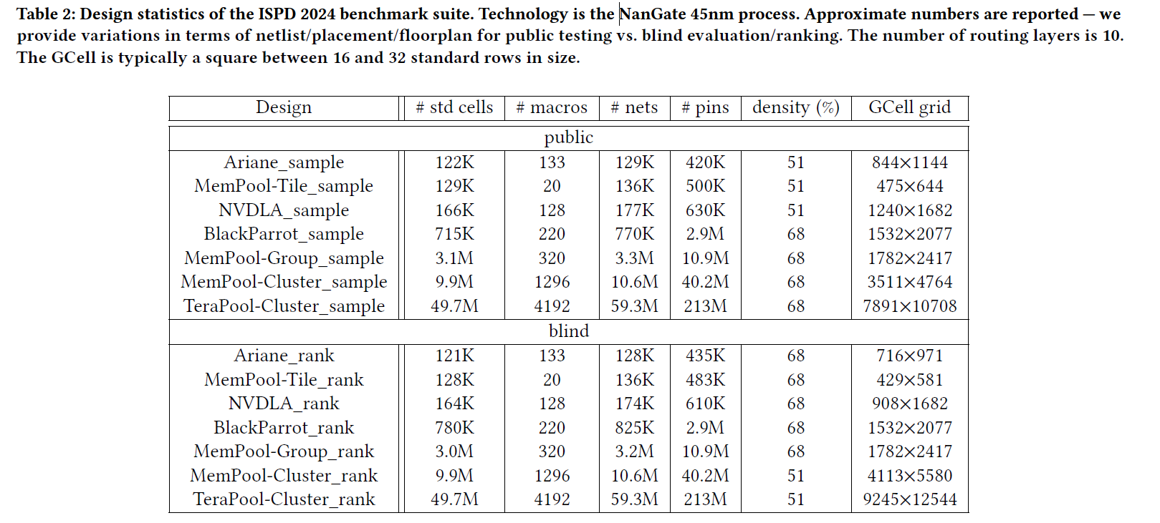
Benchmark Suit Characteristics (Cont.)

Slide 8
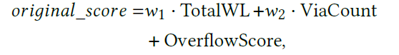
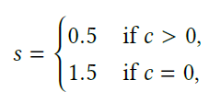
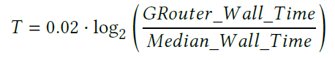
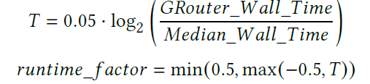
Evaluation Metric
Main track
Special honor track
Further emphasize runtime scalability to facilitate the deployment of global routing techniques in early design stages

Slide 9
Ranking
Weight-sum of the ranking of each benchmark
The weight is proportional to the cube root of the #nets of the benchmark
Design
#nets
weight
0.05
0.05
0.05
0.09
0.15
0.22
0.39

Slide 10
Evaluation Platform
RAM: 200 GB
CPU Cores: 8 cores
GPUs: 4 NVIDIA A100 GPUs

Slide 11
Participation Statistics
52 initial registrations
Asia: 33 teams
Europe: 1 team
North America: 5 teams
South America: 1 team
Others (unknown affiliations): 12 teams
18 final submissions

Slide 12
Prizes
Prizes are based on the ranking in the main track
1st place: $1000 + one NVIDIA GPU of similar value
2nd place: $500 + one NVIDIA GPU of similar value
3rd place: $250 + one NVIDIA GPU of similar value

Slide 13
Contest Results – Main Track
 | ariane |  | bsg |  | nvdla |  | mempool_tile |  | mempool_group |  | mempool_cluster |  | tera_cluster
Team | score | rank | score | rank | score | rank | score | rank | score | rank | score | rank | score | rank | weighted_rank
A | 22326149 | 3 | 1.11E+08 | 6 | 42785372 | 3 | 13808883 | 3 | 3.71E+08 | 2 | 1.72E+09 | 1 | 1.202E+10 | 1 | 1.9
B | 22126529 | 2 | 1.07E+08 | 1 | 42673699 | 2 | 13750400 | 2 | 3.77E+08 | 3 | 1.73E+09 | 2 | 1.204E+10 | 2 | 2.06
C | 21577912 | 1 | 1.07E+08 | 2 | 42129054 | 1 | 13219650 | 1 | 3.67E+08 | 1 | 1.74E+09 | 3 | 1.208E+10 | 3 | 2.31
D | 22718430 | 5 | 1.1E+08 | 4 | 43474248 | 4 | 14025624 | 5 | 3.9E+08 | 4 | 1.81E+09 | 4 | 1.256E+10 | 4 | 4.1
E | 22501510 | 4 | 1.1E+08 | 3 | 43763726 | 5 | 14094144 | 6 | 3.95E+08 | 5 | 1.85E+09 | 5 | 1.4E+10 | 6 | 5.21

Slide 14
Contest Results – Special Honor
 | ariane |  | bsg |  | nvdla |  | mempool_tile |  | mempool_group |  | mempool_cluster |  | tera_cluster
Team | score | rank | score | rank | score | rank | score | rank | score | rank | score | rank | score | rank | weighted_rank
B | 21068226 | 3 | 1.01E+08 | 2 | 40538542 | 2 | 13238490 | 3 | 3.53E+08 | 2 | 1.59E+09 | 1 | 1.14E+10 | 1 | 1.49
C | 20100380 | 1 | 1.01E+08 | 1 | 40445341 | 1 | 12309656 | 1 | 3.41E+08 | 1 | 1.67E+09 | 3 | 1.16E+10 | 2 | 1.83
A | 20845927 | 2 | 1.07E+08 | 3 | 40664270 | 3 | 12831966 | 2 | 3.53E+08 | 3 | 1.64E+09 | 2 | 1.17E+10 | 3 | 2.68
D | 22054900 | 5 | 1.08E+08 | 5 | 43566415 | 4 | 13701731 | 4 | 3.8E+08 | 4 | 1.75E+09 | 4 | 1.31E+10 | 4 | 4.14
E | 22099273 | 6 | 1.07E+08 | 4 | 44139231 | 7 | 13920117 | 6 | 3.93E+08 | 5 | 1.85E+09 | 5 | 1.4E+10 | 6 | 5.5

Slide 15
Contest Results – Summary
Team | Main track ranking | Special honor ranking
A | 1 | 3
B | 2 | 1
C | 3 | 2
D | 4 | 4
E | 5 | 5

Slide 16
Results Analysis – GPU Usage
Team | Use GPU?
A | Y
B | Y
C | N

Slide 17
Results Analysis - Deterministic
Among 18 teams in the final submission, 14 teams have deterministic solutions
Among top-3 teams in the final submission, all of them have deterministic solutions

Slide 18
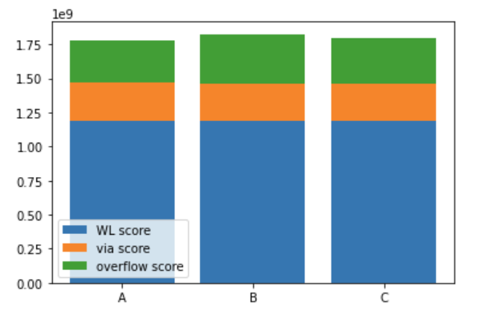
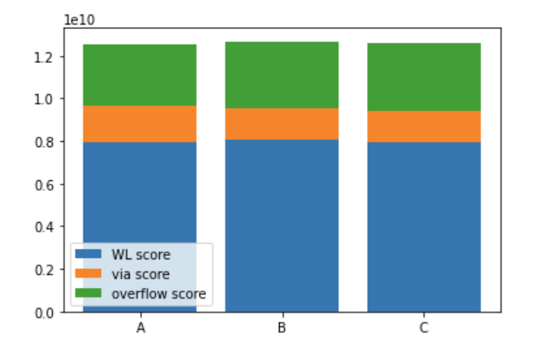
Contest Results – Score Breakdown (Main Track)
Mempool_cluster
Tera_cluster
WL score > overflow score > via score
QoR performance: Team A > Team C > Team B

Slide 19
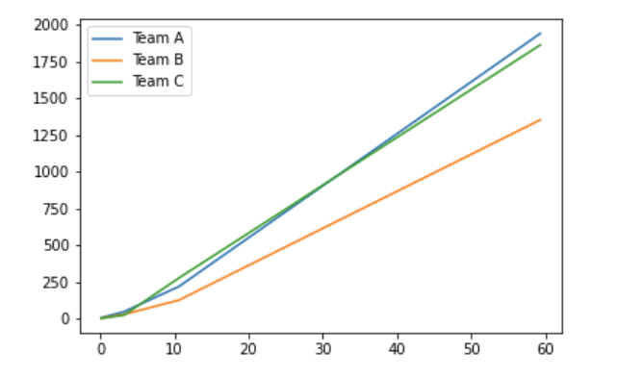
Results Analysis – Runtime Scalability (Main Track)
Runtime/s
#nets (Million)
Runtime performance: Team B > Team C ~= Team A

Slide 20
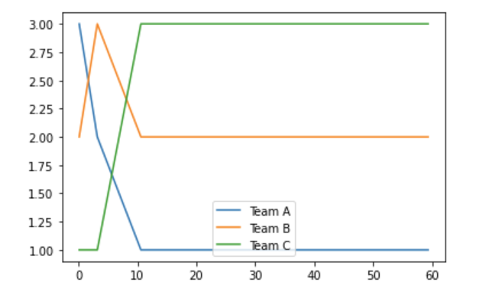
Ranking vs. #Nets (Main Track)
ranking
#nets (Million)
The larger the number of nets, the better Team A performs

Slide 21
2024 ACM International Symposium on Physical Design
GPU/ML-Enhanced Large Scale Global Routing
Honorable mention
Team etuoReL
Xingyu Tong, Guohao Chen, Benchao Zhu, Jiawei Li, Jiaming Chang, Yuzheng Lin, Yuhao Ren, Chang Liu
Fudan University
Iris Hui-Ru Jiang
General Chair
ISPD 2024
Gracieli Posser
Technical Program Chair
ISPD 2024
Rongjian Liang, Anthony Agnesina, Wen-Hao Liu, Haoxing Ren NVIDIA

Slide 22
2024 ACM International Symposium on Physical Design
GPU/ML-Enhanced Large Scale Global Routing
Honorable mention
Team SCAW
Lang Feng, Hongxin Kong, Xupengkai Lu, Xihao Liang, Junxi Feng, Xiaokun Lin, Jixiang Zhu, Junhao Guo, Wenchao Qian, Yujie Wang
Sun Yat-sen University,
Institute of Computing Technology, Chinese Academy of Sciences, and Advanced Micro Devices, Inc.
Iris Hui-Ru Jiang
General Chair
ISPD 2024
Gracieli Posser
Technical Program Chair
ISPD 2024
Rongjian Liang, Anthony Agnesina, Wen-Hao Liu, Haoxing Ren NVIDIA

Slide 23
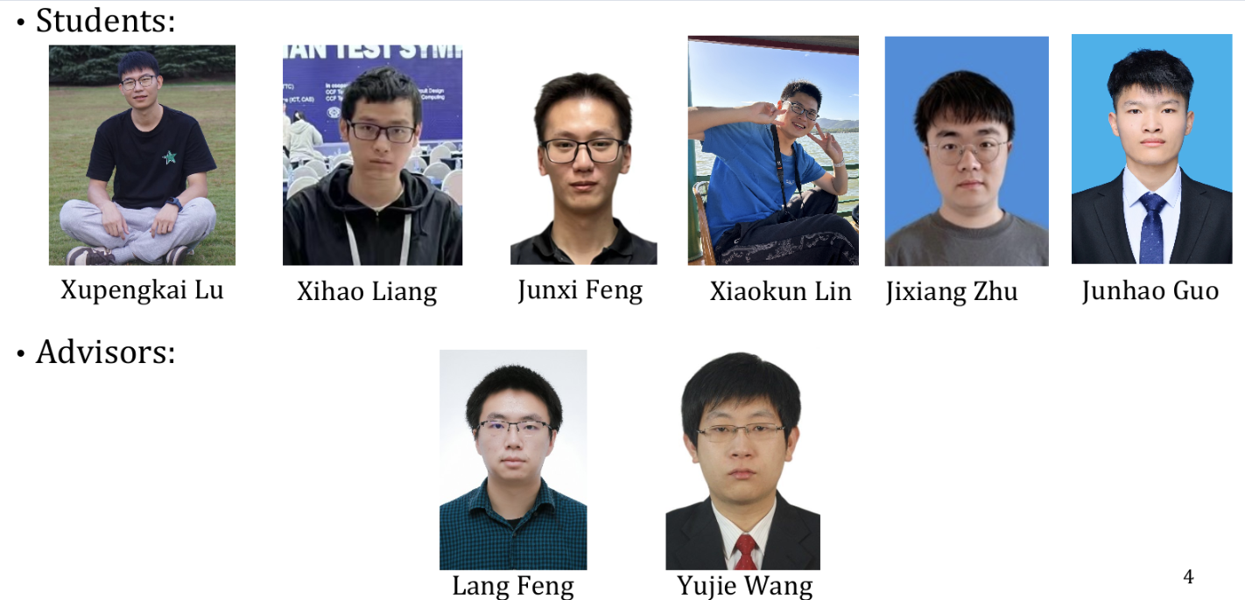
Team SCAW Members

Slide 24

Team SCAW Methodology
Congestion-Aware Net Ordering for Multi-Threading
Pattern Routing
Obstacle-Avoiding RSMT
Augmented Pattern Routing
Routing Complexity-based Configuration
Adaptive Multi-Threading
CUGR-2
Dynamic Net Filtering
Rip-up and Reroute
GPU-Accelerated Maze Routing
The opportunities for parallel computing of multiple phases are investigated, and the best configuration combination is selected

Slide 25
2024 ACM International Symposium on Physical Design
GPU/ML-Enhanced Large Scale Global Routing
THIRD PLACE
Team metaRoute
Zhijie Cai, Min Wei, Yilu Chen, Zhaoyi Wu, Hongzhi Ding, Peng Zou, Zhifeng Lin, Jianli Chen
Fudan University, Fuzhou University and Shanghai LEDA technology
Iris Hui-Ru Jiang
General Chair
ISPD 2024
Gracieli Posser
Technical Program Chair
ISPD 2024
Rongjian Liang, Anthony Agnesina, Wen-Hao Liu, Haoxing Ren NVIDIA

Slide 26
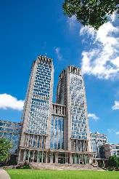
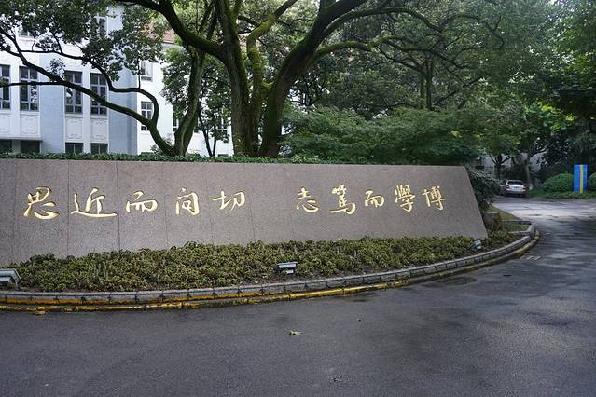
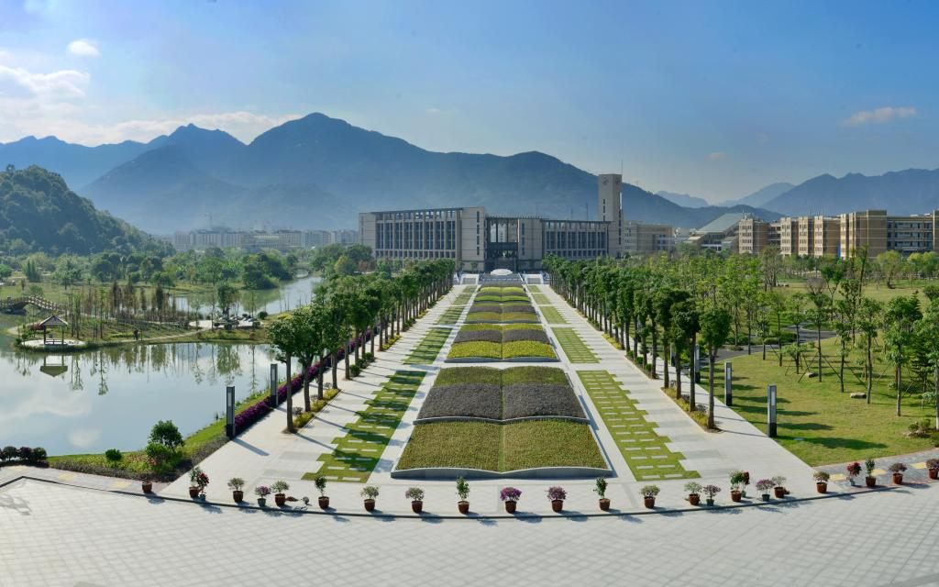
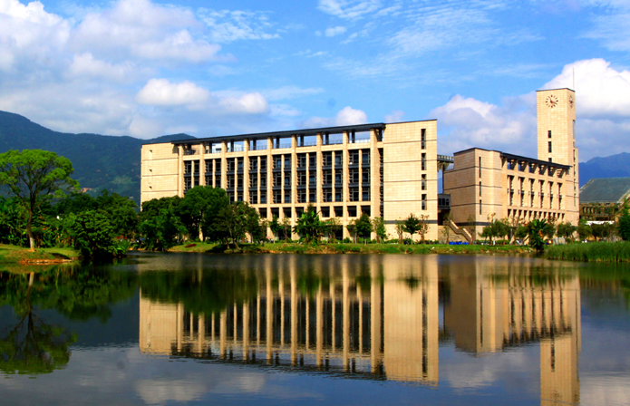
Team metaRoute members
Advisors
Zhijie Cai
Graduate Student, Fudan University
Min Wei
PhD Student, Fudan University
Yilu Chen
PhD Student, Fuzhou University
Zhaoyi Wu
Graduate Student, Fuzhou University
Hongzhi Ding
Shanghai LEDA technology
Peng Zou
Shanghai LEDA technology
Zhifeng Lin
Professor, Fuzhou University
Jianli Chen
Professor, Fudan University

Slide 27
Team metaRoute Methodology
Overview of our flow
Pin access point selection with alignment preference
Initial route by 2D pattern route and layer assignment
Analysis current overflow situation to determine next step
Rip up the problematic nets and reroute them in a parallel friendly mode
Algorithm Flow
Resource file & Net information files
Pin access point selection
Initial route
Overflow status analysis
Rip up and reroute
Final result

Slide 28
2024 ACM International Symposium on Physical Design
GPU/ML-Enhanced Large Scale Global Routing
SECOND PLACE
Team RL-Route
Shiju Lin, Liang Xiao, Jinwei Liu, Evangeline F.Y. Young
The Chinese University of Hong Kong
Iris Hui-Ru Jiang
General Chair
ISPD 2024
Gracieli Posser
Technical Program Chair
ISPD 2024
Rongjian Liang, Anthony Agnesina, Wen-Hao Liu, Haoxing Ren NVIDIA

Slide 29
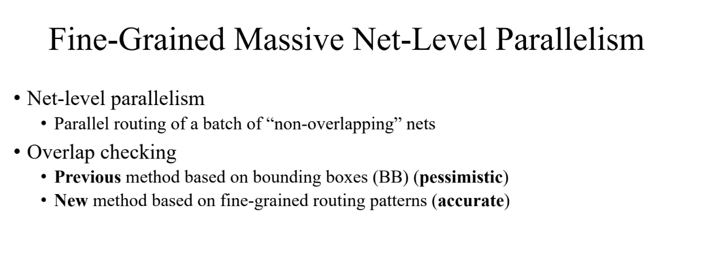
Team RL-Route Methodology

Slide 30
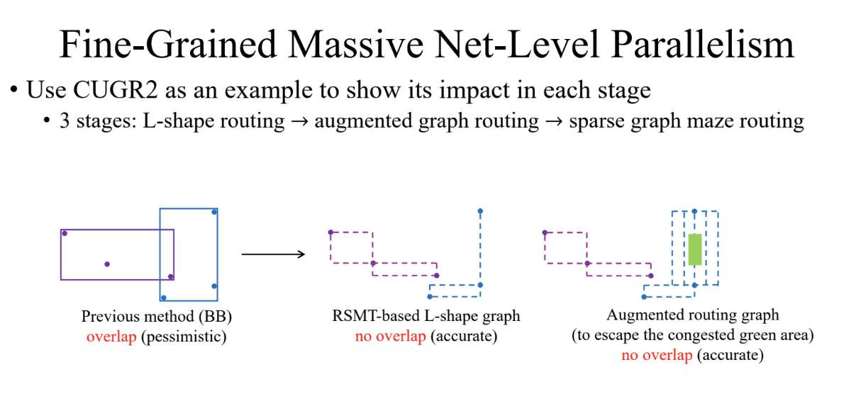

Slide 31
2024 ACM International Symposium on Physical Design
GPU/ML-Enhanced Large Scale Global Routing
FIRST PLACE
Team Hippo
Chunyuan Zhao, Yibo Lin
Peking University
Iris Hui-Ru Jiang
General Chair
ISPD 2024
Gracieli Posser
Technical Program Chair
ISPD 2024
Rongjian Liang, Anthony Agnesina, Wen-Hao Liu, Haoxing Ren NVIDIA

Slide 32
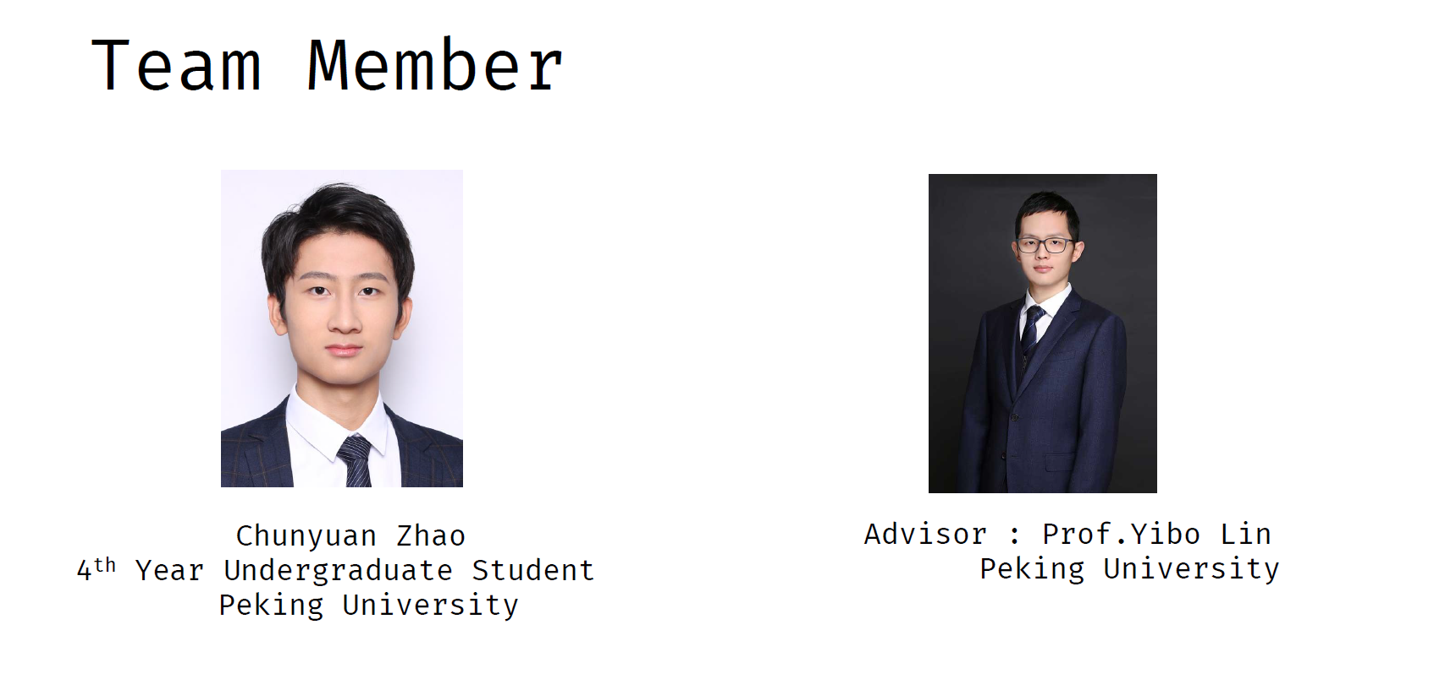
Team Hippo

Slide 33
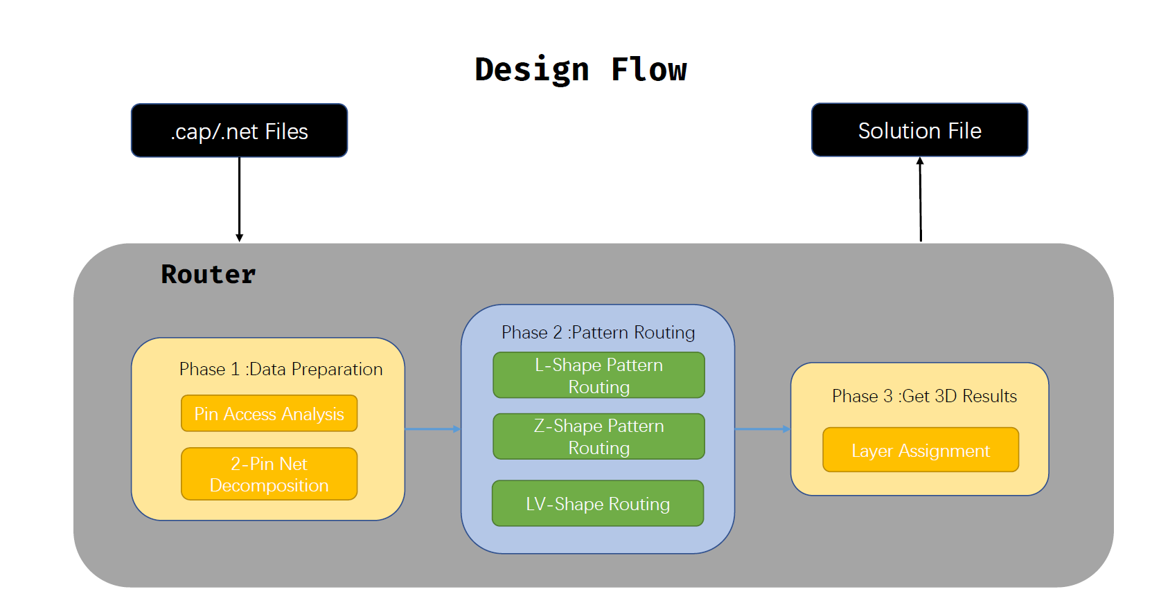
Team Hippo Methodology

Slide 34
2024 ACM International Symposium on Physical Design
GPU/ML-Enhanced Large Scale Global Routing
Honorable mention
- Special Honor track
Team etuoReL
Xingyu Tong, Guohao Chen, Benchao Zhu, Jiawei Li, Jiaming Chang, Yuzheng Lin, Yuhao Ren, Chang Liu
Fudan University
Iris Hui-Ru Jiang
General Chair
ISPD 2024
Gracieli Posser
Technical Program Chair
ISPD 2024
Rongjian Liang, Anthony Agnesina, Wen-Hao Liu, Haoxing Ren NVIDIA

Slide 35
2024 ACM International Symposium on Physical Design
GPU/ML-Enhanced Large Scale Global Routing
Honorable mention
- Special Honor track
Team SCAW
Lang Feng, Hongxin Kong, Xupengkai Lu, Xihao Liang, Junxi Feng, Xiaokun Lin, Jixiang Zhu, Junhao Guo, Wenchao Qian, Yujie Wang
Sun Yat-sen University,
Institute of Computing Technology, Chinese Academy of Sciences, and Advanced Micro Devices, Inc.
Iris Hui-Ru Jiang
General Chair
ISPD 2024
Gracieli Posser
Technical Program Chair
ISPD 2024
Rongjian Liang, Anthony Agnesina, Wen-Hao Liu, Haoxing Ren NVIDIA

Slide 36
2024 ACM International Symposium on Physical Design
GPU/ML-Enhanced Large Scale Global Routing
THIRD PLACE
- Special Honor track
Team Hippo
Chunyuan Zhao, Yibo Lin
Peking University
Iris Hui-Ru Jiang
General Chair
ISPD 2024
Gracieli Posser
Technical Program Chair
ISPD 2024
Rongjian Liang, Anthony Agnesina, Wen-Hao Liu, Haoxing Ren NVIDIA

Slide 37
2024 ACM International Symposium on Physical Design
GPU/ML-Enhanced Large Scale Global Routing
SECOND PLACE
- Special Honor track
Team metaRoute
Zhijie Cai, Min Wei, Yilu Chen, Zhaoyi Wu, Hongzhi Ding, Peng Zou, Zhifeng Lin, Jianli Chen
Fudan University, Fuzhou University and Shanghai LEDA technology
Iris Hui-Ru Jiang
General Chair
ISPD 2024
Gracieli Posser
Technical Program Chair
ISPD 2024
Rongjian Liang, Anthony Agnesina, Wen-Hao Liu, Haoxing Ren NVIDIA

Slide 38
2024 ACM International Symposium on Physical Design
GPU/ML-Enhanced Large Scale Global Routing
FIRST PLACE
- Special Honor track
Team RL-Route
Shiju Lin, Liang Xiao, Jinwei Liu, Evangeline F.Y. Young
The Chinese University of Hong Kong
Iris Hui-Ru Jiang
General Chair
ISPD 2024
Gracieli Posser
Technical Program Chair
ISPD 2024
Rongjian Liang, Anthony Agnesina, Wen-Hao Liu, Haoxing Ren NVIDIA

Slide 39
Acknowledgment
David Chinnery - Siemens Digital
Gracieli Posser – Cadence
Andrew Kahng – University of California at San Diego, OpenROAD
Matt Liberty – OpenROAD
Evangeline F.Y. Young – The Chinese University of Hong Kong
Fangzhou Wang - The Chinese University of Hong Kong
Yangqing Zhang – NVIDIA
Haoyu Yang – NVIDIA
Mingjie Liu - NVIDIA

Slide 40
Web page: ISPD24 Contest: GPU/ML-Enhanced Large Scale Global Routing | ISPD24_contest (liangrj2014.github.io)
Email: ispd2024contest@gmail.com

Slide 41
CERTIFICATE OF APPRECIATION
presented to
Rowan Devereux-Smith, Patrick Madden
Binghamton University
Session Participant

Slide 42
CERTIFICATE OF APPRECIATION
presented to
Ting-Chi Wang, Che-Ping Tsai, Jie-Hong Liu, Wen-Xuan Chen, Min-Feng Hsieh, Lu-Ying Wu
National Tsing Hua University
Session Participant

Slide 43
CERTIFICATE OF APPRECIATION
presented to
Zhiyang Chen, Chengkai Wang, Haochang Tian, Xu ZHang
Tsinghua University, University of Science and Technology Beijing
Session Participant

Slide 44
CERTIFICATE OF APPRECIATION
presented to
Ruizhi Liu, Xueyan Zhao, Zhisheng Zeng, Jikang Liu, Xingquan Li, Dongbo Bu
Institute of Computing Technology, Chinese Academy Sciences, Shenzhen University, Peng Cheng Laboratory
Session Participant

Slide 45
CERTIFICATE OF APPRECIATION
presented to
Jaekyung Im, Joonyoung Seo, Wonjin Choi, Dowon Son, Seokhyeong Kang
POSTECH
Session Participant

Slide 46
CERTIFICATE OF APPRECIATION
presented to
Cheng-Hsiu Hsieh, Chung-En Ho
National Taiwan University
Session Participant

Slide 47
CERTIFICATE OF APPRECIATION
presented to
Siting Liu, Shui Jiang, Jiaxi Jiang, Peng Xu, Su Zheng, Bei Yu, Tsung-Yi Ho
The Chinese University of Hong Kong
Session Participant

Slide 48
CERTIFICATE OF APPRECIATION
presented to
Yu-Tse Chen, Pang-Chun Chao, Hung-Yi Yang
Session Participant

Slide 49
CERTIFICATE OF APPRECIATION
presented to
Cheng-Yu Chiang, Yan-Jen Chen, Chao-Chi Lan, Zong-Ying Cai
National Taiwan University
Session Participant

Slide 50
CERTIFICATE OF APPRECIATION
presented to
Pengju Yao, Ping Zhang, Junkang Jiang, Wenxing Zhu
Fuzhou University
Session Participant

Slide 51
CERTIFICATE OF APPRECIATION
presented to
Canhui Luo, Jinghu Liang, Xun Ni, Long Zhang, Zhouxing Su, Zhipeng Lv
Huazhong University of Science and Technology
Session Participant

Slide 52
CERTIFICATE OF APPRECIATION
presented to
Zhengzhe Zheng, Jinghui Zhou, Yinuo Wu, Xingling Zheng, Ziran Zhu
Southeast University
Session Participant

Slide 53
CERTIFICATE OF APPRECIATION
presented to
Anthony Wing Ho Lau, Qijing Wang, Xinshi Zang, Evangeline F.Y. Young
The Chinese University of Hong Kong
Session Participant

